Slide 1
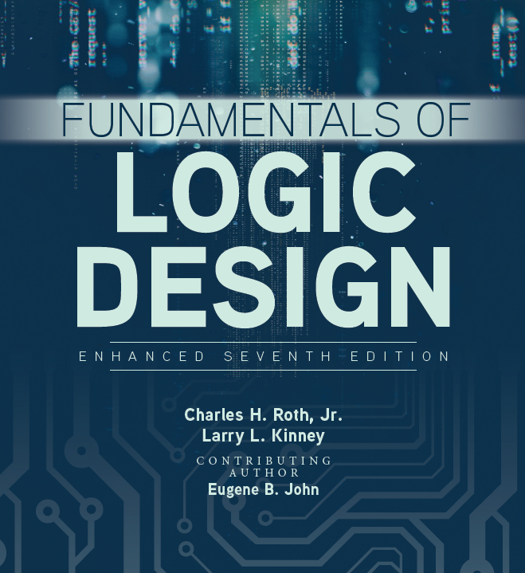

Lab 23. Sequence detector

Slide 2
Design Procedure
1.Derive the state diagram from the word description and specifications of the desired operation
2.Reduce the number of states(introduced next week)
3.Assign binary values to the states
4.Obtain the binary-coded state table
5.Choose the type of flip-flops to be used
6.Derive the simplified flip-flop input equations and output equations
7.Draw the logic diagram

Slide 3
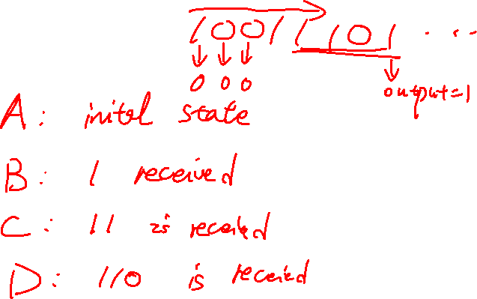
Design Example- Sequence recognizer
We need to design a circuit that detects a sequence 1101 in a string of bits coming from an input line (i.e. the input is in serial bit stream)
State diagram

Slide 4

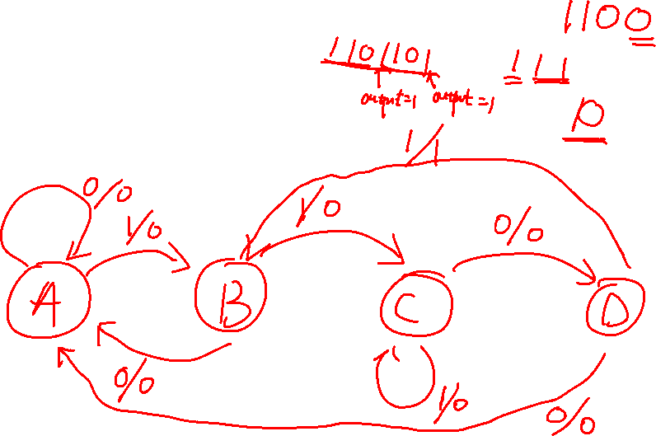

Slide 5
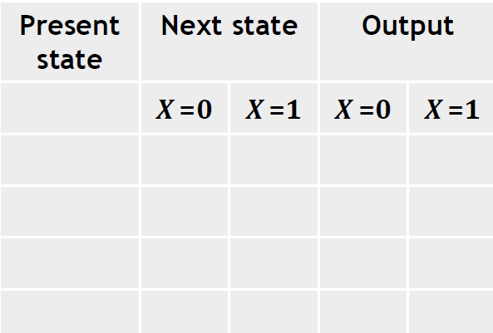
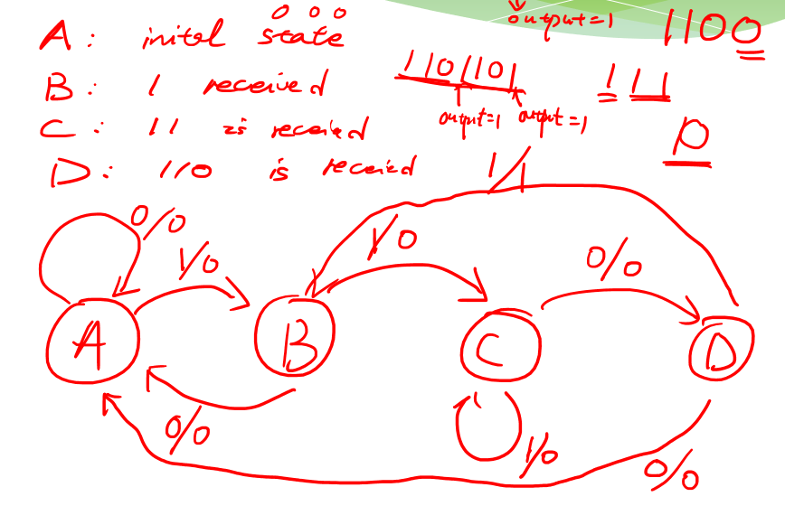

Design Example- Sequence recognizer
State table

Slide 6
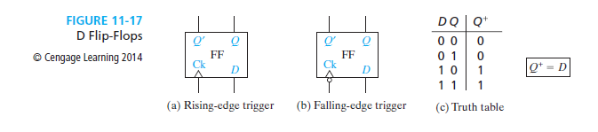
D Flip-Flop

Slide 7
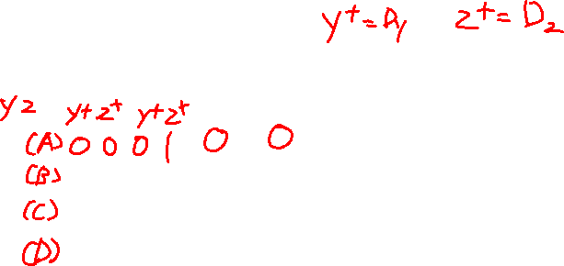
Derive the input and output equation
Present state | Next state |  | Output
 | X =0 | X =1 | X =0 | X =1
00
01
11
10
For D flip flop: D=Q⁺
YZ
X
00 01 11 10
D
0
Y
1
YZ
X 00 01 11 10
YZ
X
00 01 11 10
D
0
F
0
Z
1
1

Slide 8
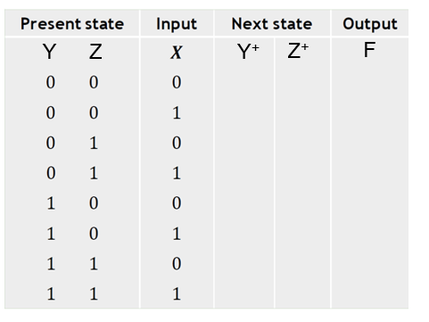
YZ
X
00 01 11 10
D
0
Y
1
YZ
X
00 01 11 10
YZ
X 00 01 11 10
F
0
D
0
1
Z
1

Slide 9
Design Example- Sequence recognizer
Boolean expression
𝑫_{𝒀} =
𝑫_{𝒁} =
𝑭 =
Logic diagram

Slide 10
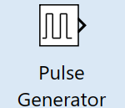
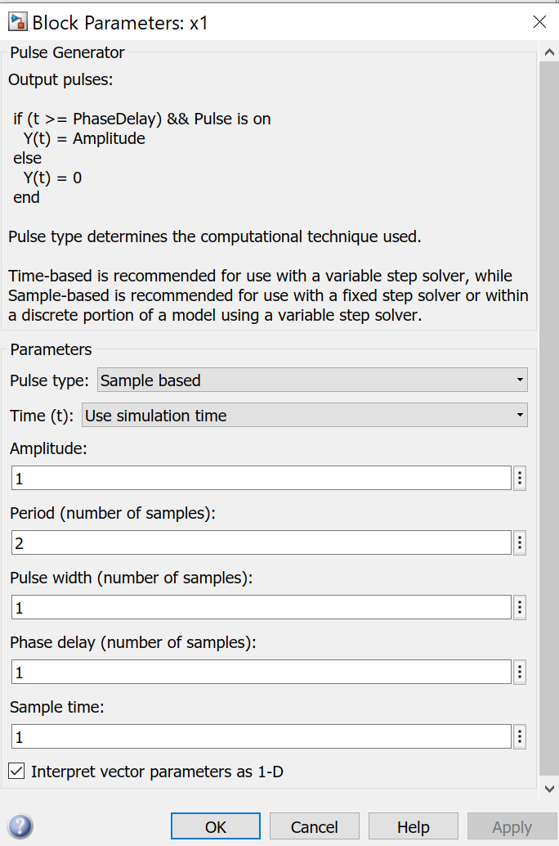
Simulation
Use two D flip flops
Clock signal: Pulse generator

Slide 11
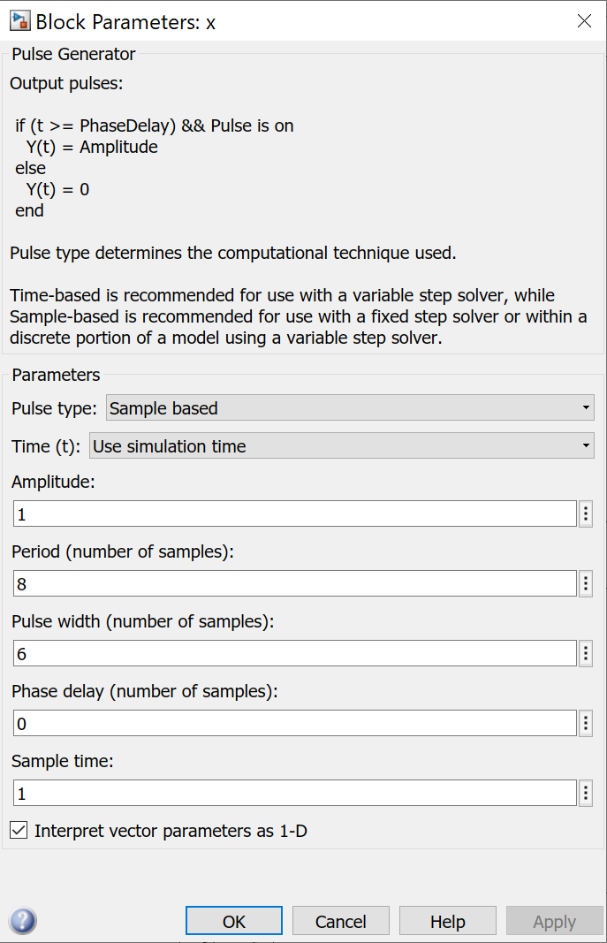
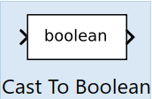
Simulation
Input signal x: Pulse generator
Careful: Only if x is
directly taken as the input to flip flop,
you need to use a Boolean conversion
to convert signal into binary signal

Slide 12
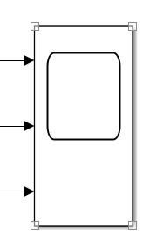
Simulation
Scope has three ports to observe the clock signal, input signal and the output
Set stop time as 40
Show me the waveforms on the scope

